Slide 1
RavenDB
Lecturer: Ngo Huy Bien
Software Engineering Department
Faculty of Information Technology
VNUHCM - University of Science
Ho Chi Minh City, Vietnam
nhbien@fit.hcmus.edu.vn

Slide 2

Objectives
To install and start RavenDB.
To write data to RavenDB.
To read data from RavenDB.

Slide 3

Contents
Chocolatey
RavenDB

Slide 4

References

Slide 5
RavenDB
https://ravendb.net/learn/inside-ravendb-book/reader/4.0/1-welcome-to-ravendb
RavenDB is a high performance, distributed, NoSQL document database.
RavenDB is also an ACID database, unlike many other NoSQL databases.

Slide 6
What is Chocolatey?
https://docs.chocolatey.org/en-us/
Chocolatey brings the concepts of true package management to allow you to version things, manage dependencies and installation order.

Slide 7
Why Chocolatey?
https://chocolatey.org/docs/why
Chocolatey builds on technologies that are familiar:
PowerShell
Unattended installations
How much effort do you go through to set a tool and all of its requirements up on your machine?
Do you realize that all of this manual effort is a pain?
It's something we just do and don't realize we are wasting time doing all of this manual process.
And worse, when we install applications it's always... Next Next Next Finish.

Slide 8
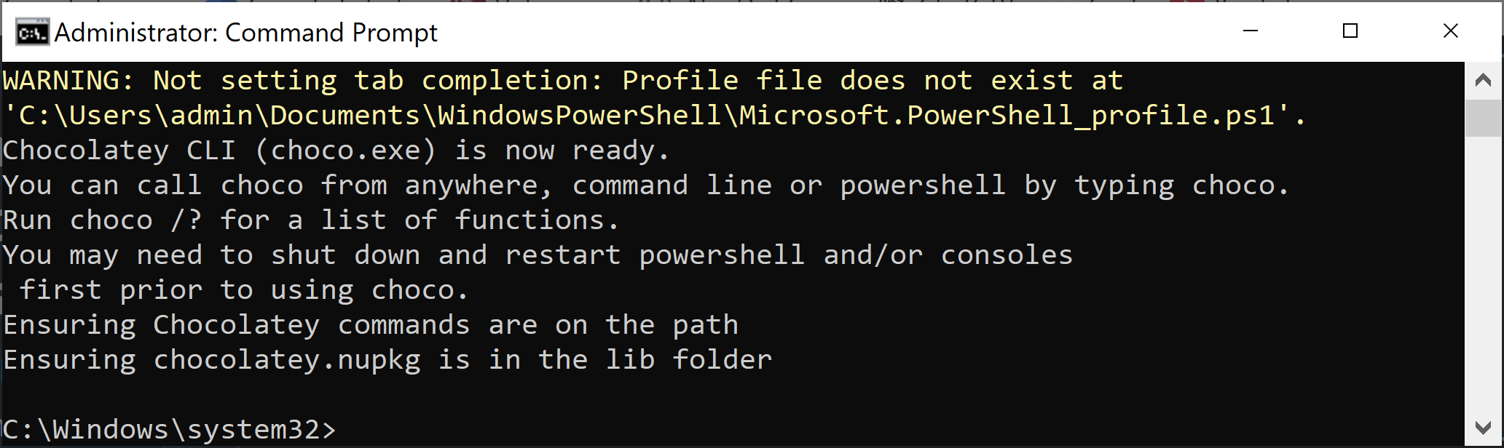
1. Install Chocolatey
https://docs.chocolatey.org/en-us/choco/setup/
@"%SystemRoot%\System32\WindowsPowerShell\v1.0\powershell.exe" -NoProfile -InputFormat None -ExecutionPolicy Bypass -Command "[System.Net.ServicePointManager]::SecurityProtocol = 3072; iex ((New-Object System.Net.WebClient).DownloadString('https://community.chocolatey.org/install.ps1'))" && SET "PATH=%PATH%;%ALLUSERSPROFILE%\chocolatey\bin"

Slide 9
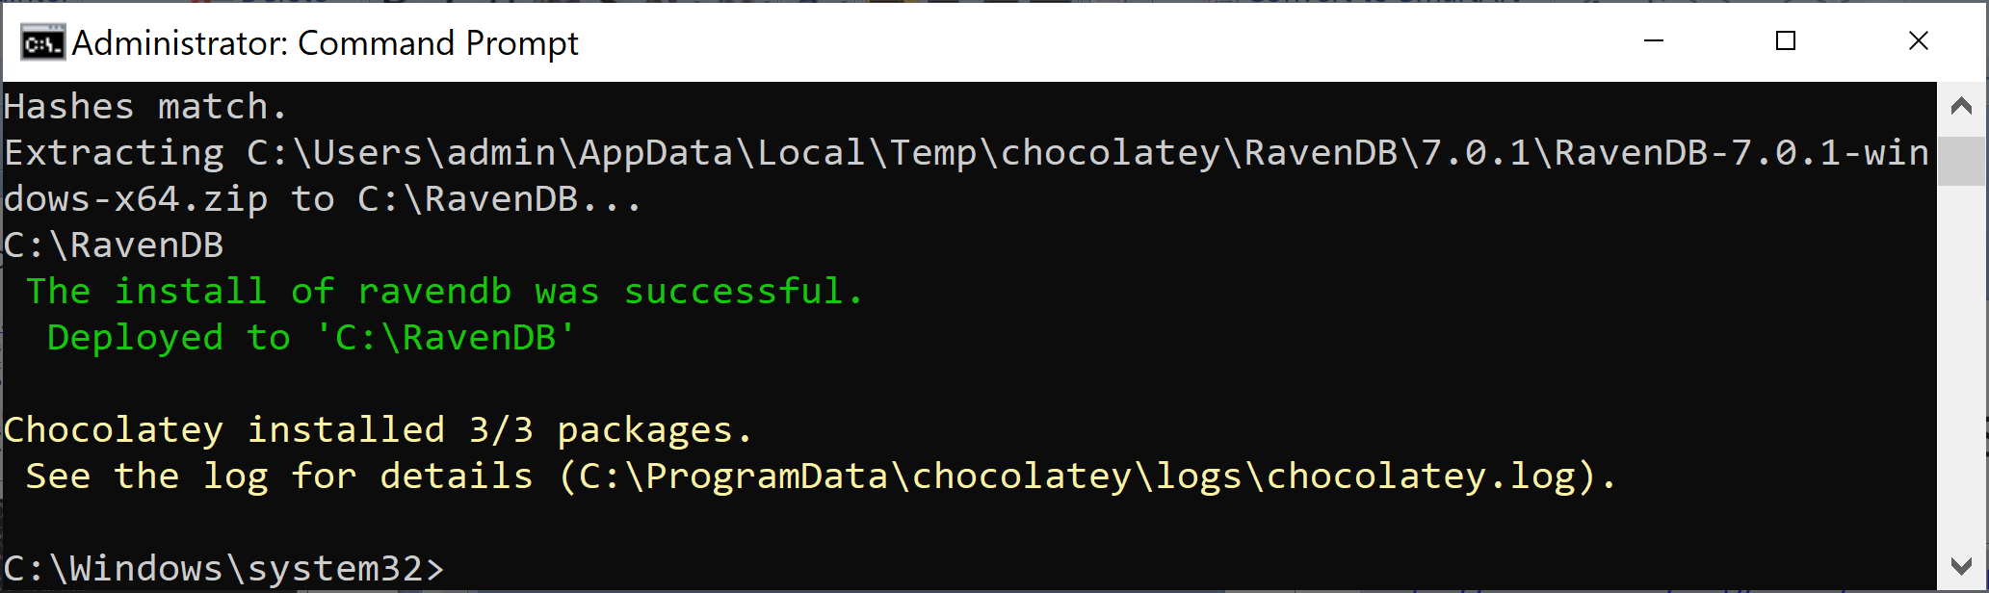
2. Search for and Install a Package
https://chocolatey.org/docs/commands-list
choco list
choco search ravendb
choco install ravendb

Slide 10
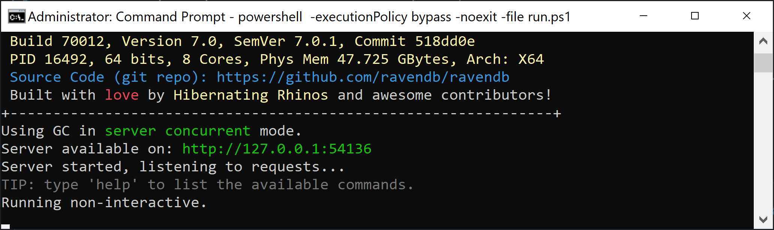
3. Run a Package
cd C:\RavenDB
powershell -executionPolicy bypass -noexit -file run.ps1

Slide 11
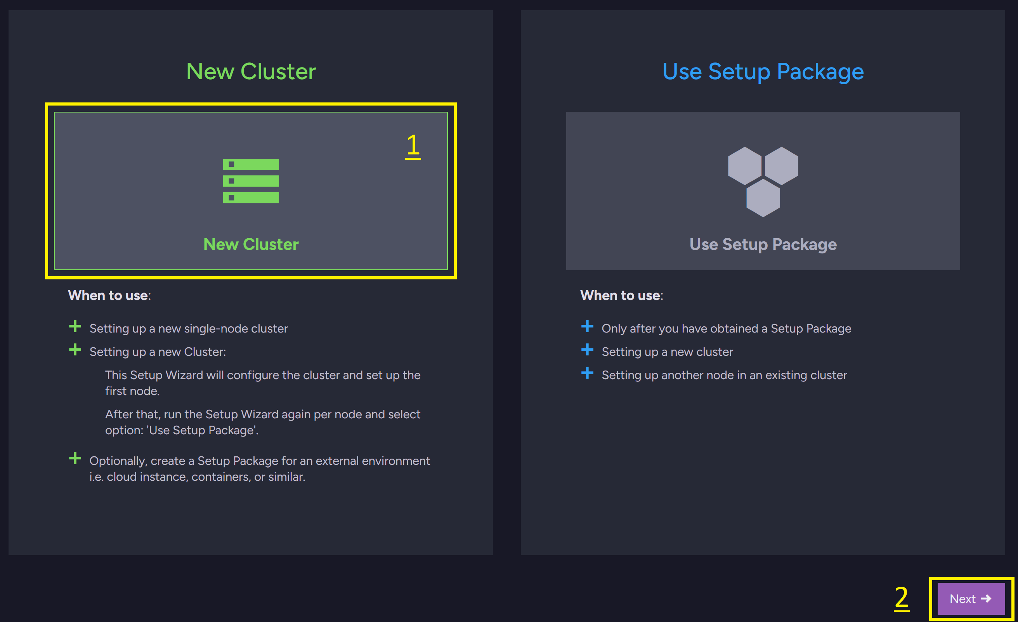
4. Set up New Single Node Cluster

Slide 12
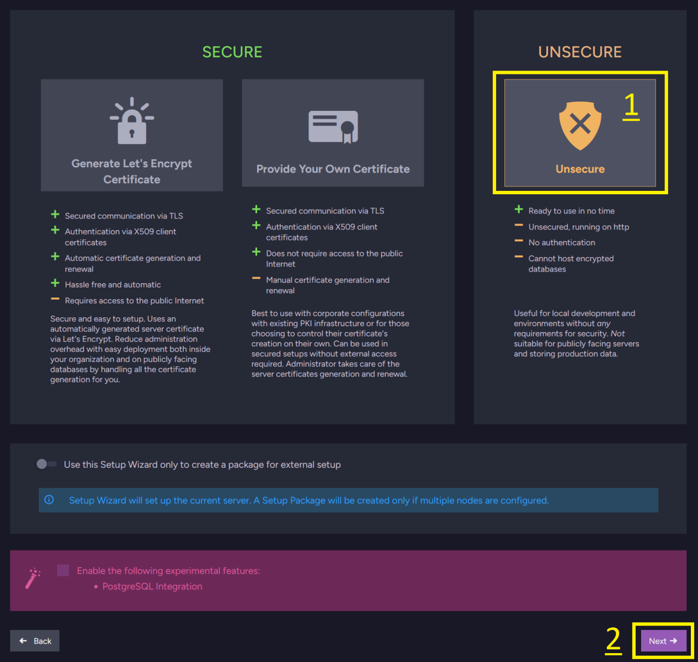
5. Select Unsecure Security Level

Slide 13
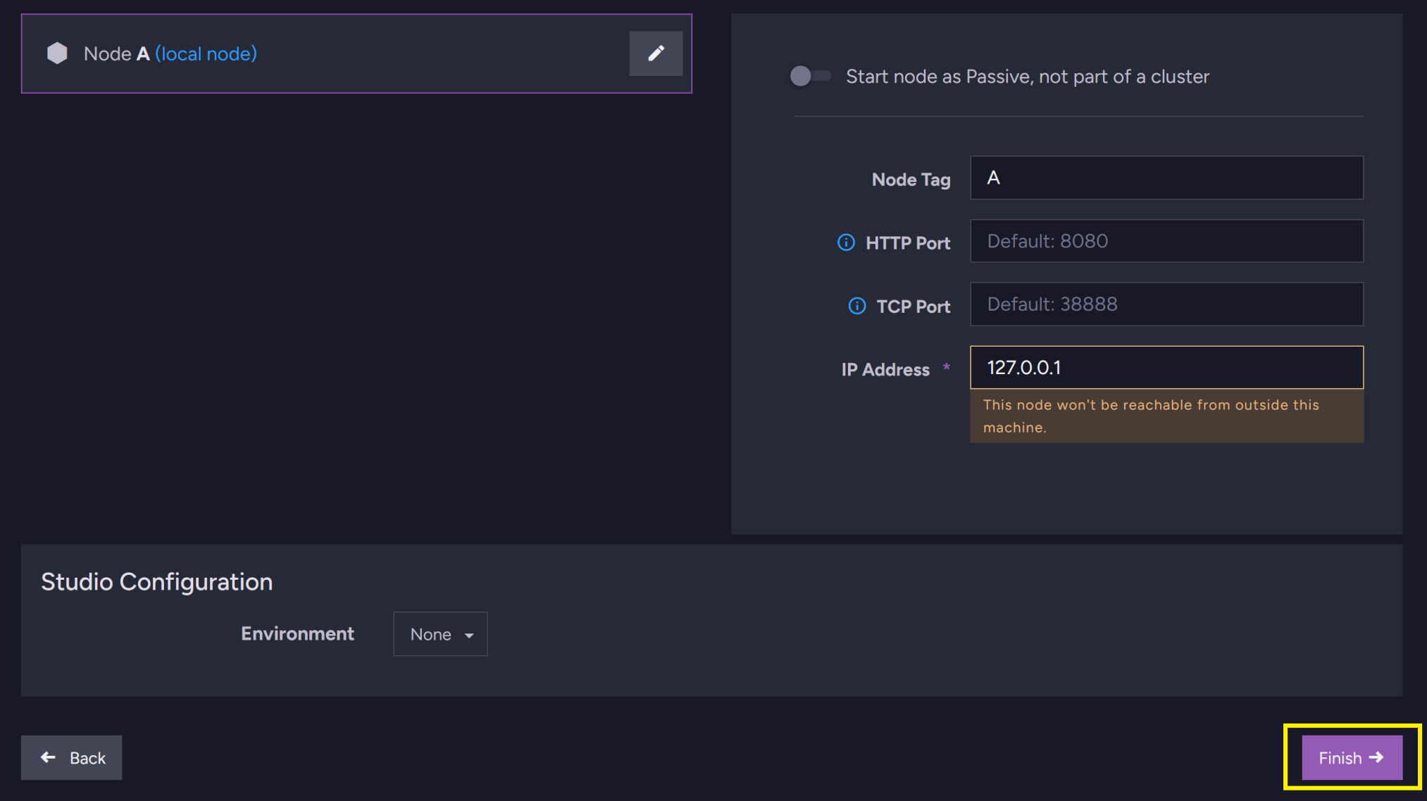
6. Finish Wizard

Slide 14
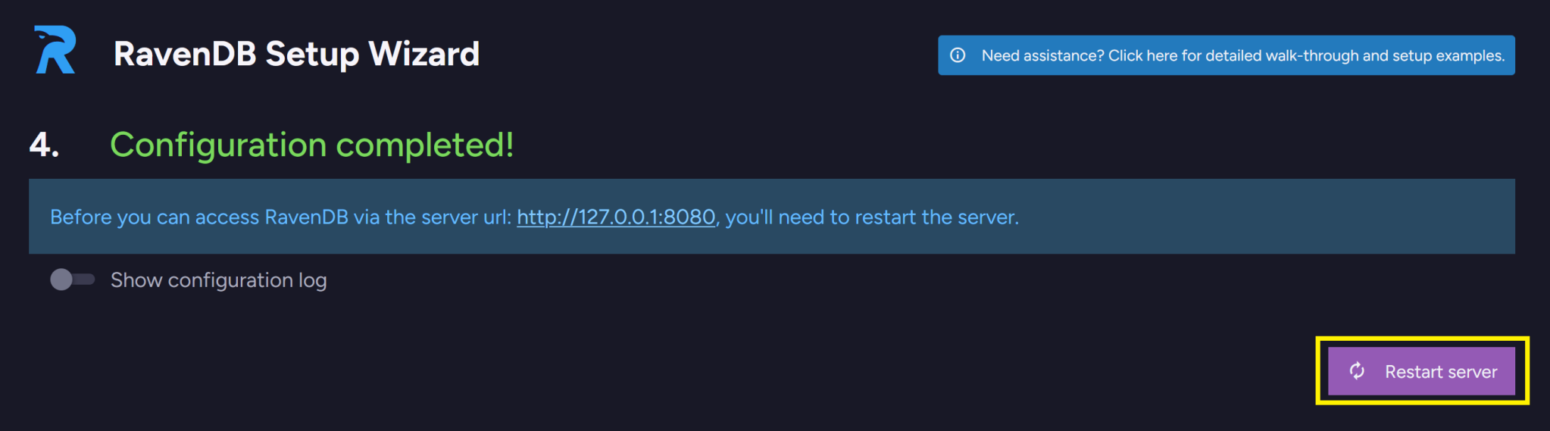
7. Restart Server

Slide 15
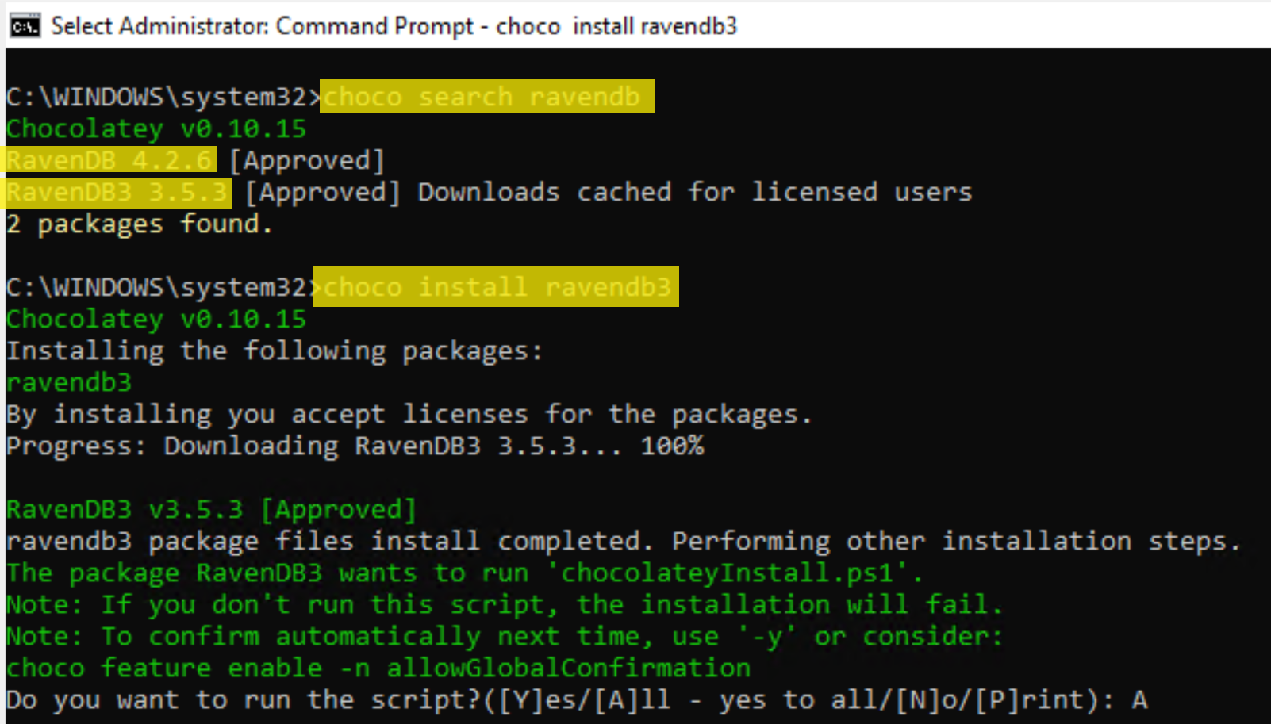
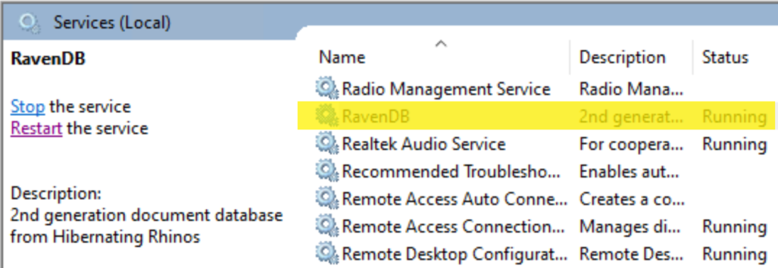
Downgrading a Package
choco uninstall ravendb
choco search ravendb
choco install ravendb3

Slide 16


Slide 17
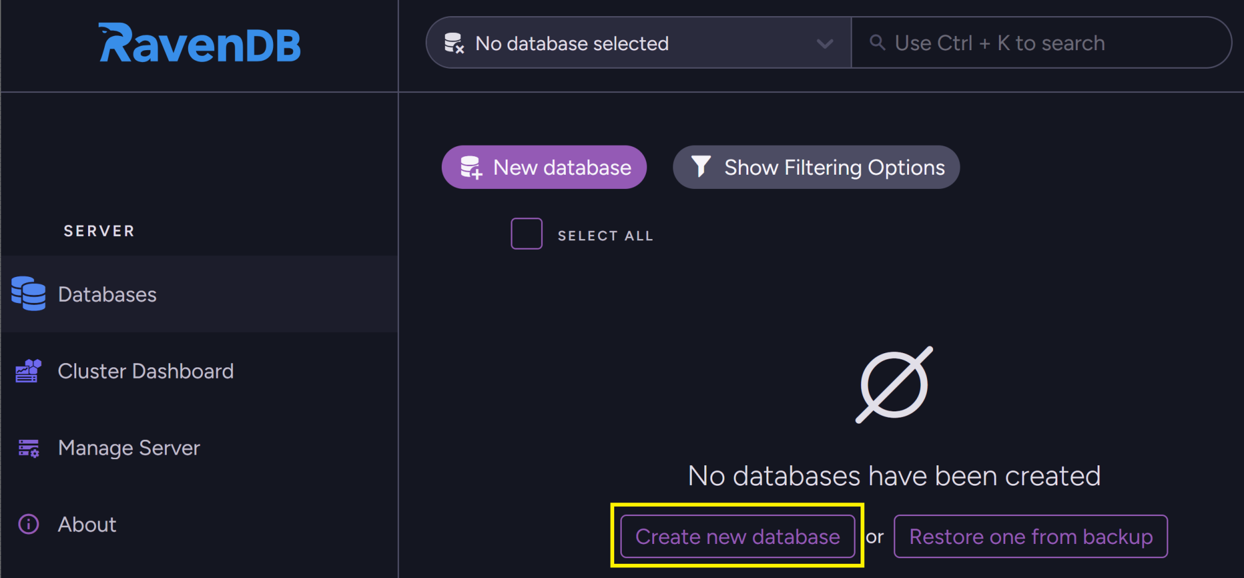
1. Create a Database

Slide 18
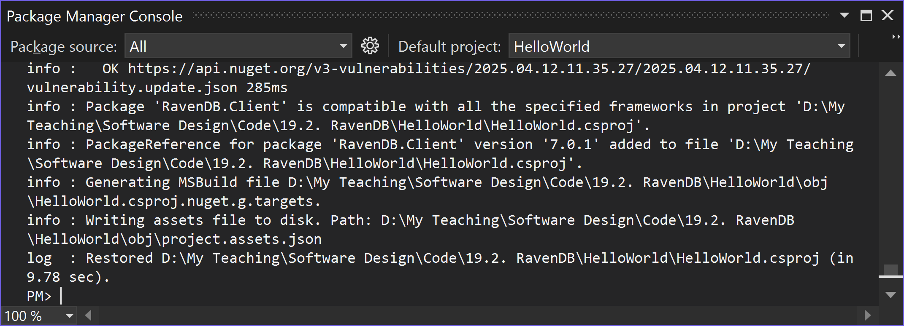
2. Install RavenDB.Client for .NET
https://www.nuget.org/packages/RavenDB.Client/
dotnet add package RavenDB.Client --version 7.0.1

Slide 19
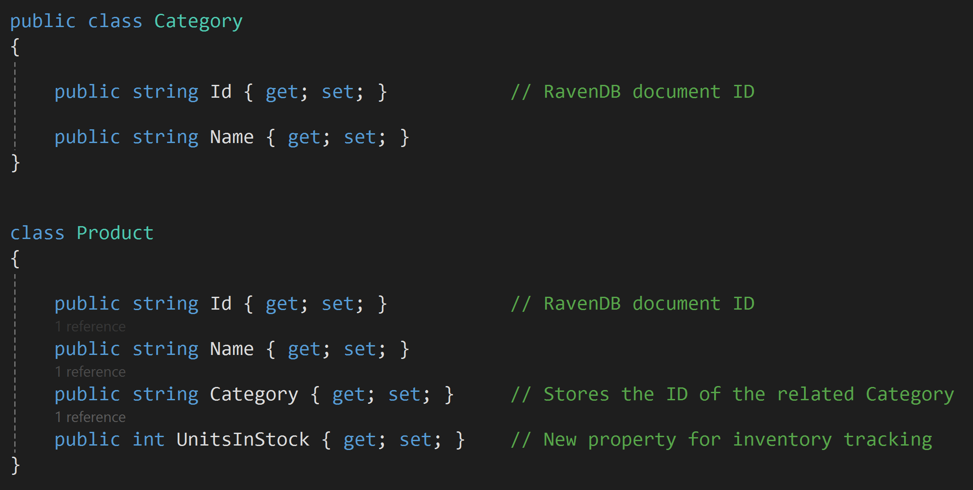
3. Create a Model

Slide 20
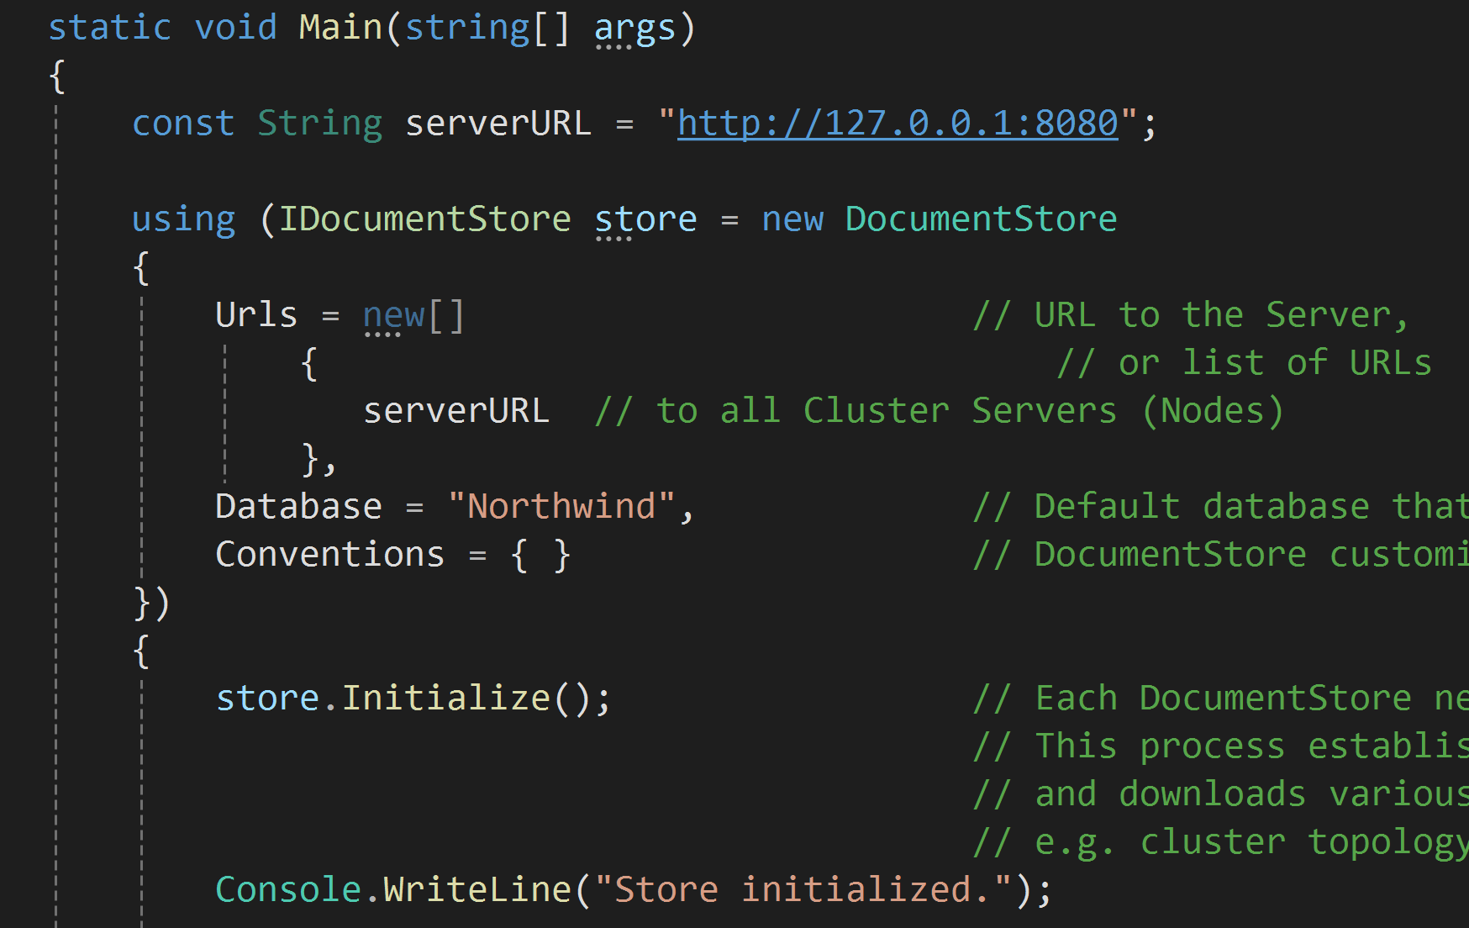
4. Initialize a DocumentStore
https://ravendb.net/docs/article-page/7.0/csharp/start/getting-started

Slide 21
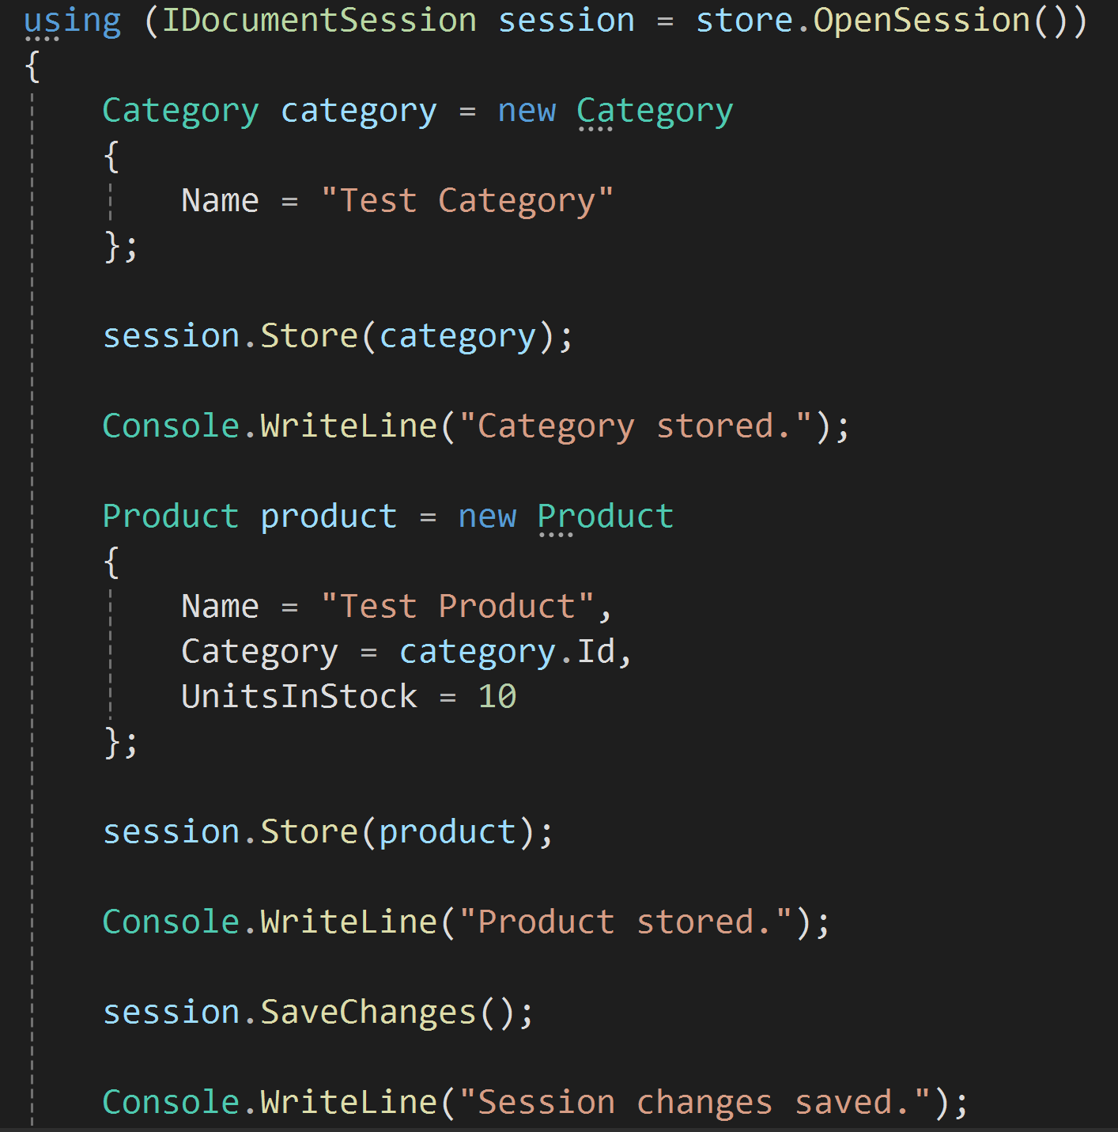
5. Store Data
RavenDB is a Document Database. All stored objects are called documents.
Each document contains a unique ID that identifies it, data and adjacent metadata, both stored in JSON format.
The metadata contains information describing the document, e.g. the last modification date (@last-modified property) or the collection (@collection property) assignment.

Slide 22
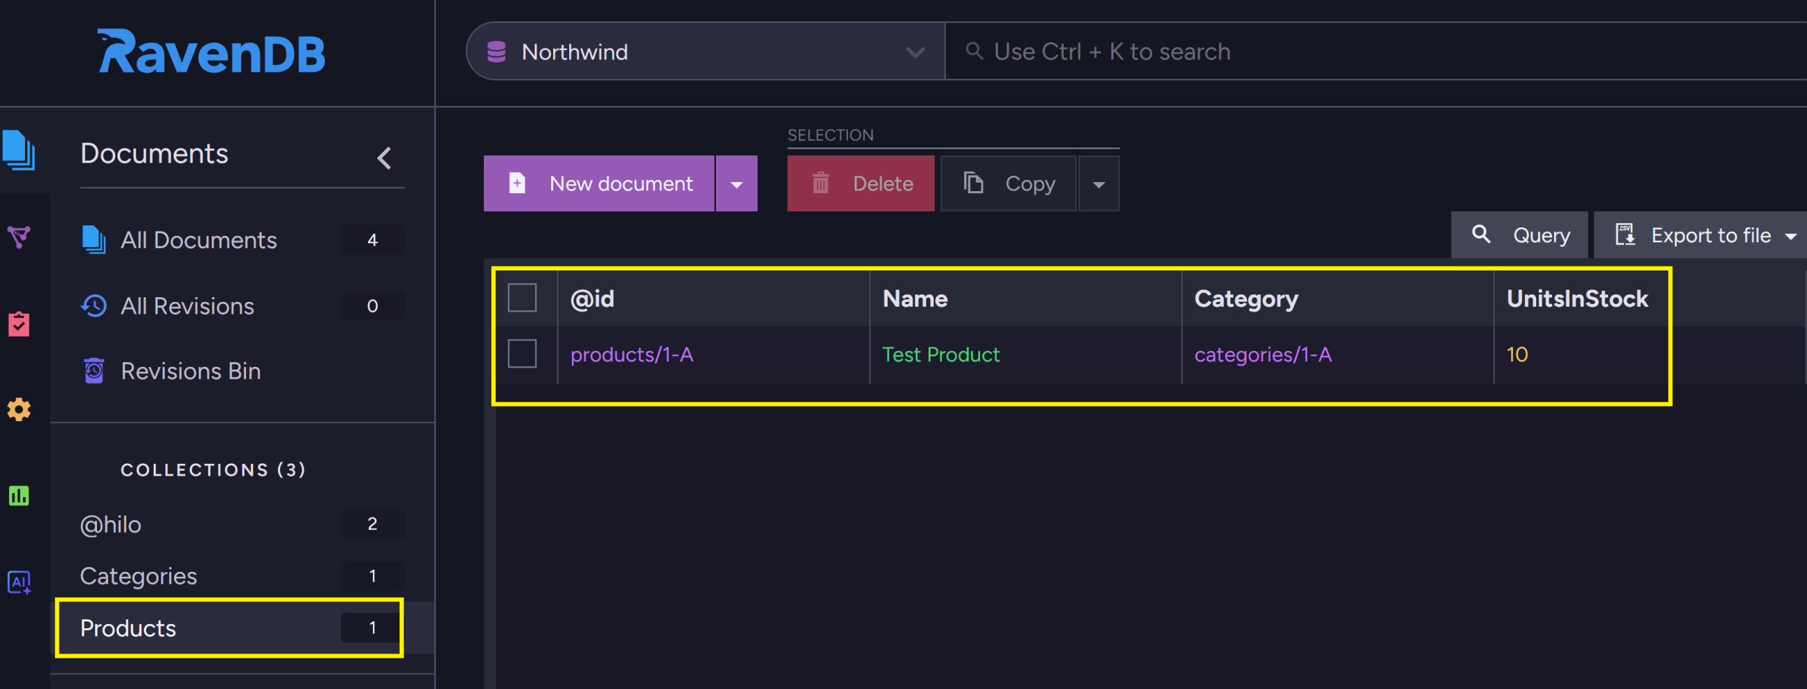
6. Verify Stored Data

Slide 24
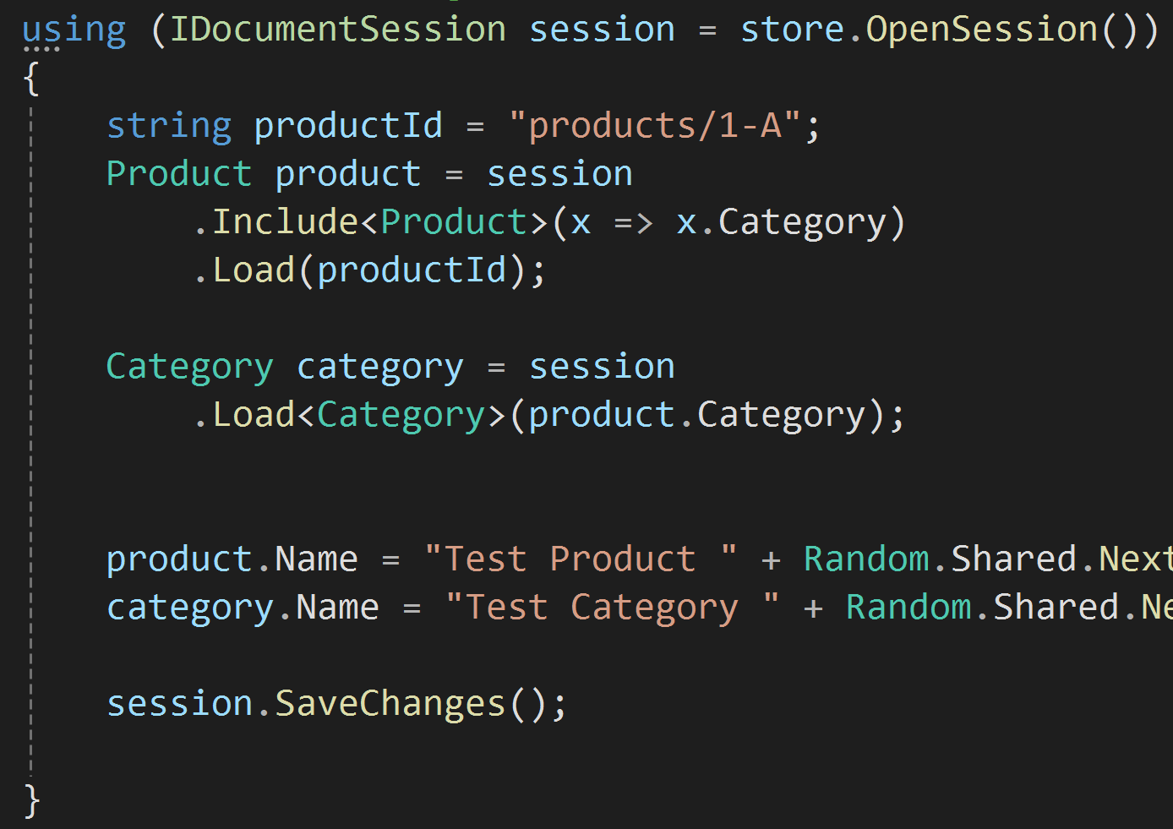
1. Load Data
The Session was designed to help the user write efficient code easily.
For example, when a document is being loaded (.Load) from the server, there is an option to retrieve additional documents in the same request (using .Include), minimizing the number of expensive calls.

Slide 25
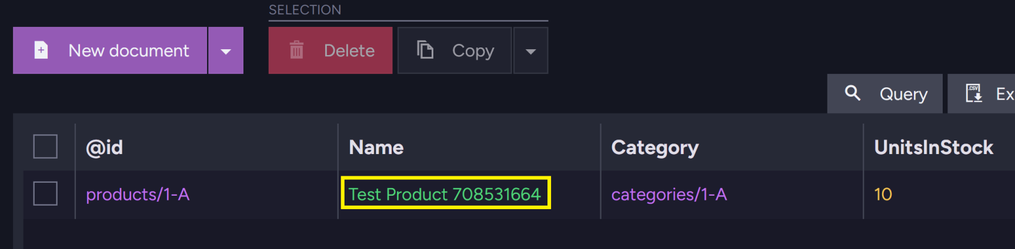
2. Verify Stored Data

Slide 27
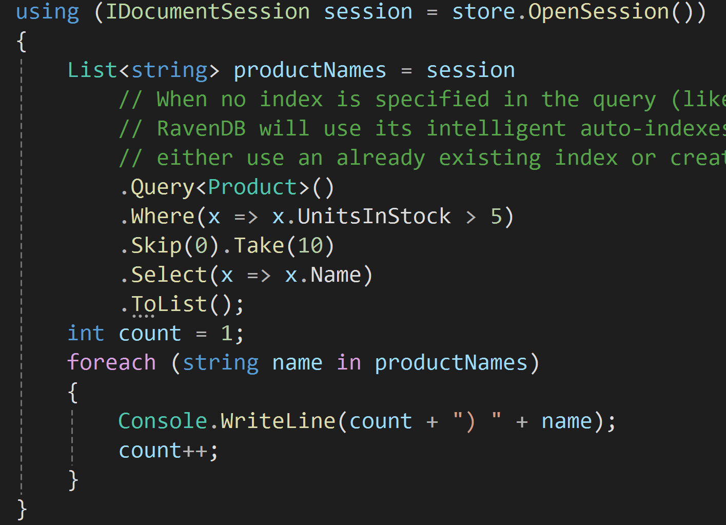
1. Query Data
To satisfy queries, indexes are used. From the querying perspective, an index defines which document fields can be used to find a document.
The whole indexing process is done asynchronously, which gives very quick querying response times, even when large amounts of data have been changed.
However, an implication of this approach is that the index might be stale.

Slide 29
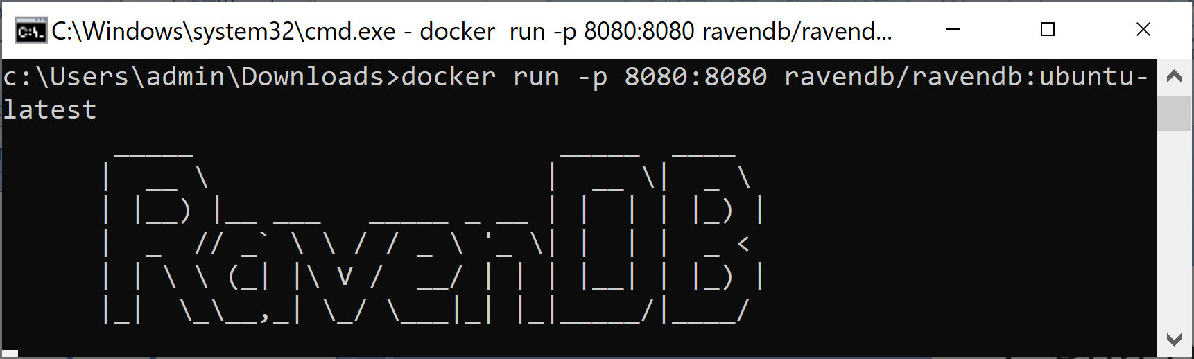
1. Run Docker Linux Image
https://hub.docker.com/r/ravendb/ravendb
docker run -p 8080:8080 ravendb/ravendb:ubuntu-latest

Slide 30
2. Connect to the Server
http://127.0.0.1:8080/studio/index.html

Slide 32
1. Allow Remote Connections
Stop the server.
Open C:\RavenDB\Server\settings.json
Change the IP to 0.0.0.0
{
"DataDir": "RavenData",
"License.Eula.Accepted": true,
"Setup.Mode": "Unsecured",
"Security.UnsecuredAccessAllowed": "PublicNetwork",
"ServerUrl": "http://0.0.0.0:8080",
"ServerUrl.Tcp": "tcp://0.0.0.0:38888"
}
Start the server.

Slide 33

Thank You & See You Again

